Slide 1
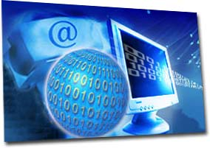
The Internet
Computer Tech Class
August 20, 2012

Slide 2
History of the Internet
Internet was originally started by Department of Defense
Was made as means of communication without central location
First started in 1960s
Not meant for common person

Slide 3
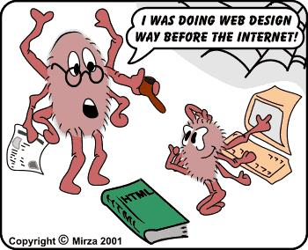
What do we use the Internet for?
Research
News
Weather
Shopping
Communication
Business
School

Slide 4
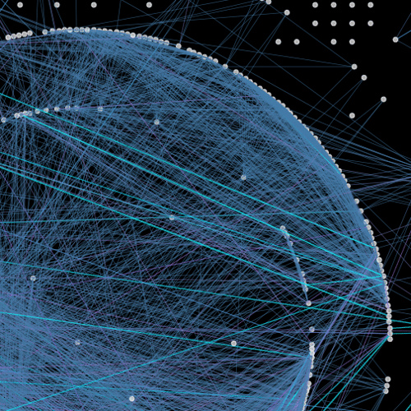
What is the Internet?
Definition: a network of millions of computers around the world
It is a network of other networks
Part of the Internet is the World Wide Web

Slide 5
How do we get Connected?
There are several ways to get connected to the Internet:
Dial-Up
DSL
Cable
T1 or T3
Wireless (Satellite)

Slide 6
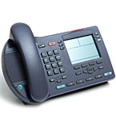
Dial-Up
Out-dated way of connecting to the Internet
Signal was carried through phone wire
Tied up phone while connected

Slide 7
DSL
Digital Subscriber Line
Carries through phone line as well
Uses a higher frequency band
Can be used at the same time as telephone
“Constant” connection

Slide 8
Cable
Signal carried through coaxial cable
You receive the signal through cable company
About the same download speed as DSL

Slide 9
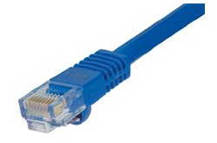
T1 or T3 Lines
Direct connection to ISP
Very fast connection & reliable signal
T3 is an upgrade from T1 lines

Slide 10
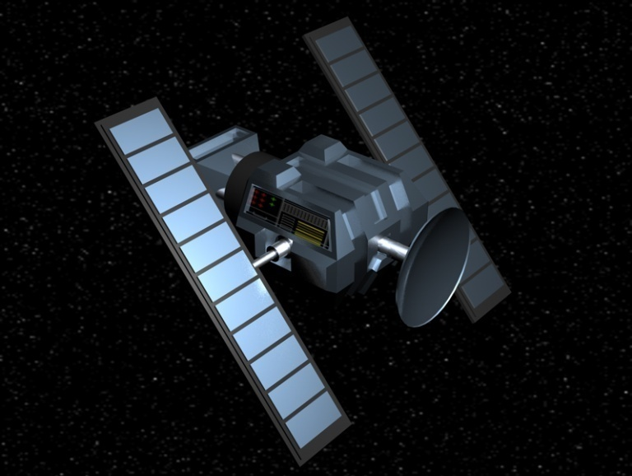
Wireless Connection
Covers a wide variety
Signal can be received directly from satellite
Good for people who cannot receive DSL or cable

Slide 11
Internet Service Provider
You must have an Internet Service Provider
Who can this be?
Phone company (DSL)
Cable Company (cable connection)
AOL, etc.

Slide 12
What is the World Wide Web?
The world wide web (www) is a series of interlinked hypertext documents
What allows us to see the www?
A web browser
Examples: Internet Explorer, Firefox, Safari (Apple), Chrome (Google)
Documents on WWW in HTML (hypertext markup language)

Slide 13
Webpage, Website
What is the difference between a webpage and a website?
Webpage: a document connected to the World Wide Web and viewable by anyone connected to the Internet who has a web browser
Website: a collection of “pages” or files linked together and available on the World Wide Web
Who can have a webpage?
Anyone with a computer and a connection to the Internet

Slide 14
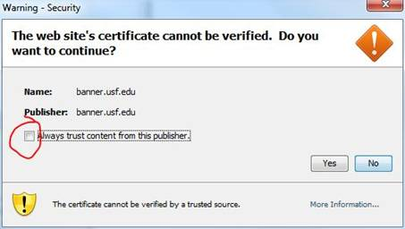
Who is real & who is not?
Where did you get the web address from?
Business card
Commercial
Ad from newspaper
Install Web Filtering Software
Dan’s Guardian
Fortiguard
Web browser: certificate cannot be verified
Cooperative Databases: Use Caution
Wikianswers
Answers.com
Yahoo! Answers

Slide 15
Social Networks
Examples
Facebook
MySpace
Twitter
Pros:
Keep in touch with many people
No travel
Fast
Cons:
Identity Fraud
Can be too Personal

Slide 16
Other Popular Sites
YouTube
Video sharing website
Can be entertaining, can be harmful
Skype
Software that allows users to make voice calls over the Internet
Can also use text & video
Much cheaper compared to traditional phone calls
Google
Popular search engine
Allows users to search millions of websites using key words
Wikipedia
Online Encyclopedia
Users are the ones to make entries
Information can be questionable

Slide 17
Cyber-bullying
The use of information and communication technologies to support deliberate, repeated, and hostile behavior be an individual or group, that is intended to harm others
Video

Slide 18
How Can you Protect yourself?
Tell your parents who you are communicating with and through what sites.
Never get too personal with anyone.
Do not communicate with anyone you do not know.
Report any uncomfortable situations.

